Slide 1
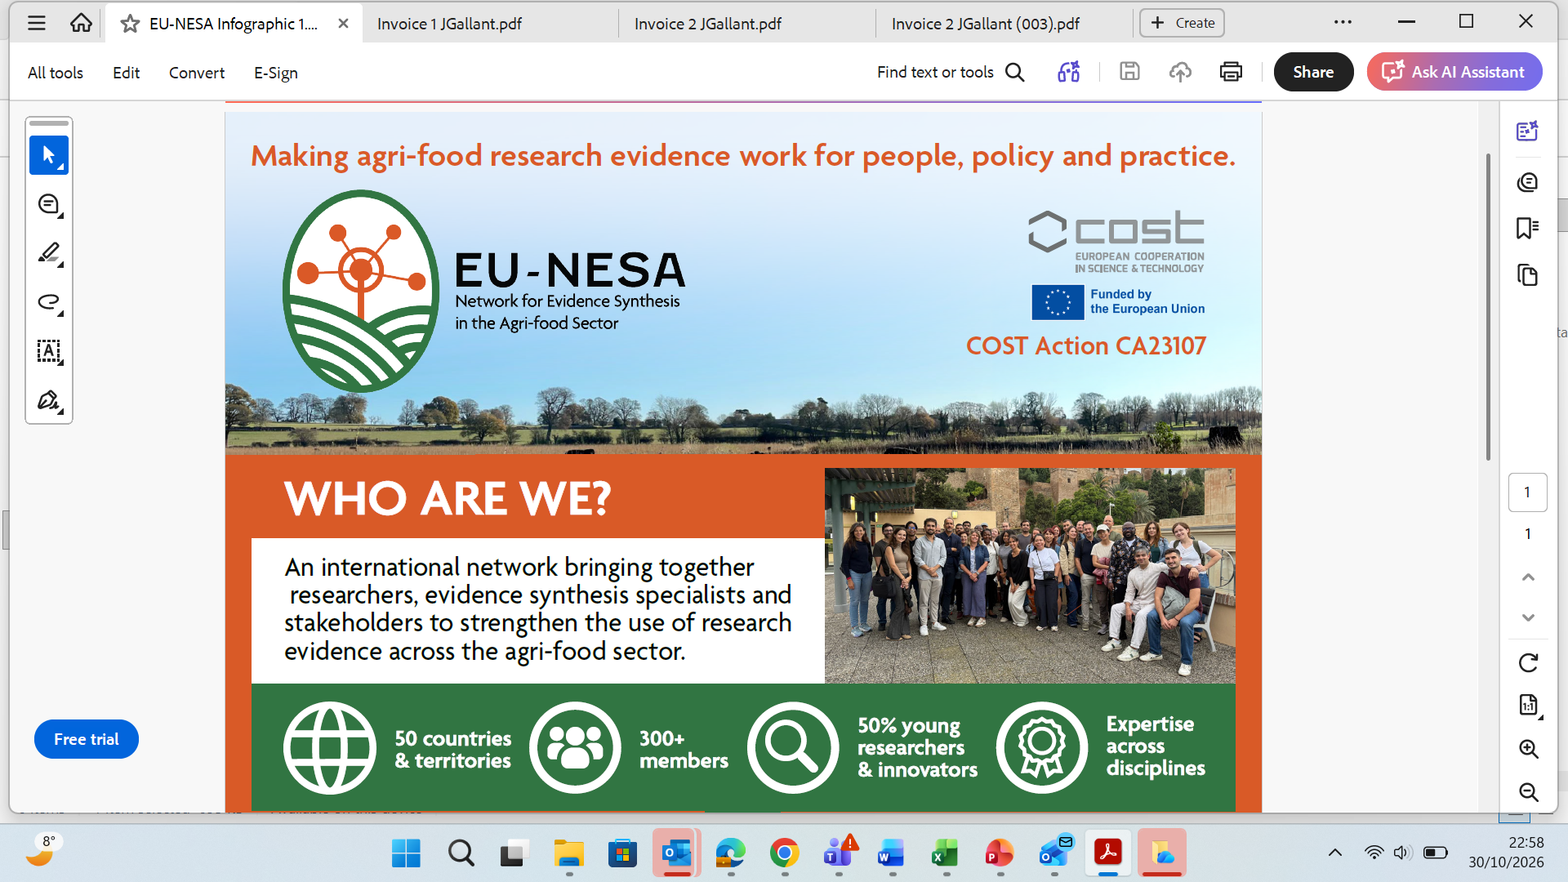

Slide 2
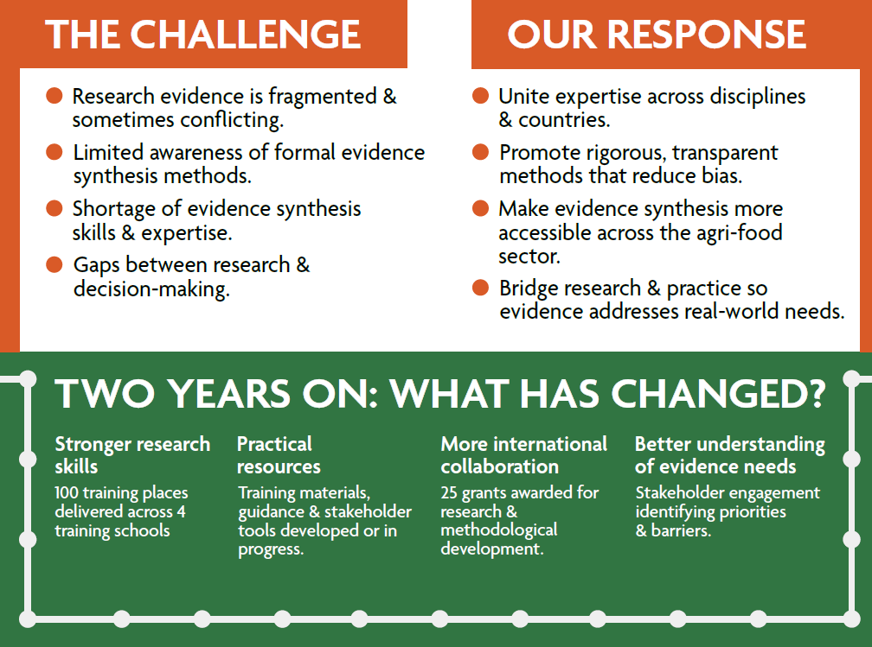

https://www.cost.eu/actions/ca23107/

Slide 3
